Slide 1

Java Web Services

Slide 2

PRESENTED BY
Muhammad Waleed Ahmed 02-131242-119

Slide 3
Introduction

Slide 4

Java Web Services
Understanding Service-Oriented Architecture in Java
Definition: Java Web Services are platform-independent APIs enabling applications to interact over the web using protocols like HTTP and XML/JSON.
Purpose: Facilitate interoperability across diverse platforms and systems by using open standards for communication.
Key Technologies: SOAP, REST are the core technology stack.
Photo by apoorv mittal on Unsplash

Slide 5



History and Evolution
Milestones in Java Web Services Development
Early 2000s
Introduction of SOAP and WSDL; Java API for XML-Based RPC (JAX-RPC) emerges as an early standard.
Mid 2000s
JAX-WS replaces JAX-RPC with annotations-based model; RESTful paradigm gains popularity.
2010s and beyond
Rise of JAX-RS, JSON-B, microservices, Docker, and cloud-native deployment techniques.
Notes:
The history of Java Web Services is closely linked to the evolution of the Internet and enterprise software architecture. In the early 2000s, the need for interoperable and standardized communication protocols led to the creation of SOAP and WSDL. Java developers initially used JAX-RPC to create SOAP-based web services.
As REST began gaining traction for its lightweight nature and alignment with HTTP protocols, the Java ecosystem responded by developing JAX-WS and eventually JAX-RS, making it easier to build and consume both SOAP and RESTful services. These improvements significantly reduced complexity by introducing annotations and reducing boilerplate code.
More recently, web service architecture in Java has embraced cloud-native paradigms. Technologies such as Docker, Kubernetes, and CI/CD pipelines have reshaped the way services are deployed and maintained. This shift also supports newer standards like JSON-B, increasing the relevance and efficiency of Java web services in modern software development.

Slide 6
SOAP Web Services

Slide 7
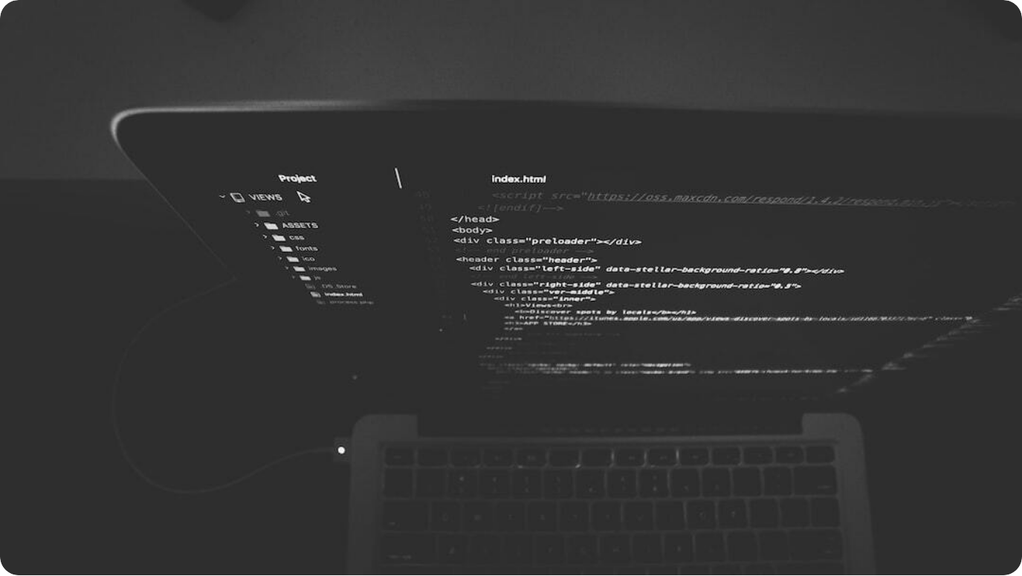
SOAP Fundamentals
SOAP is a protocol that encompasses numerous standards for message format, including WSDL for service description and XML for message exchange. It is known for its extensibility, neutrality, and independence, allowing it to work across various platforms.
by Nate Grant on Unsplash

Slide 8
Java API for XML Web Services (JAX-WS)
Building SOAP Services with Java Annotations
Annotation-Based: Simplifies service creation using annotations like @WebService and @WebMethod.
WSDL Generation: Automatically generates WSDL from annotated Java classes for client interoperability.
Tool Support: Supported by major IDEs and tools like wsgen, streamlining development and deployment.
Photo by apoorv mittal on Unsplash
Notes:
JAX-WS (Java API for XML Web Services) revolutionized the way SOAP web services are developed in Java. Instead of relying on verbose configuration files, JAX-WS utilizes annotations such as @WebService and @WebMethod directly within Java classes. This dramatically reduces complexity and improves readability.
One of the key advantages of JAX-WS is its ability to automatically generate WSDL documents from annotated classes. This enables seamless integration with client applications regardless of their platform or language.
Moreover, JAX-WS is well-supported by Java development environments like Eclipse and IntelliJ, as well as tools like wsgen for generating artifacts. This makes it an ideal choice for developers needing robust and standards-compliant web services in enterprise environments.

Slide 9




Implementing SOAP with JAX-WS
A typical SOAP web service in Java can be created using JAX-WS. The following example illustrates a simple service:
@WebService
public class HelloService {
@WebMethod
public String sayHello(String name) {
return "Hello " + name;
}
}
This service can be accessed via a WSDL file, allowing clients to consume it reliably.
Practical Steps to Develop and Deploy
Create Service Class
Annotate with @WebService and define operations using @WebMethod.
Generate WSDL
Use 'wsgen' to generate WSDL and artifacts from Java classes.
Deploy and Test
Deploy on servlet containers like Tomcat; test using SOAP UI or Postman.
Notes:
Implementing SOAP services with JAX-WS is straightforward yet powerful. The development starts by defining a service class annotated with @WebService, and each method intended for remote access is marked with @WebMethod. This declarative approach improves clarity and aligns closely with business logic.
After coding, developers generate the WSDL and supporting artifacts using the `wsgen` tool. These files serve as contracts that allow clients to bind and consume the web service across various platforms, maintaining consistency and interoperability.
Deployment typically occurs on servers like Apache Tomcat or any Java EE-compliant container. Testing tools such as SOAP UI or Postman enable thorough validation of request/response formats, headers, and fault handling, ensuring a robust and compliant SOAP-based service.

Slide 10
SOAP Code Examples
A typical SOAP web service in Java can be created using JAX-WS. The following example illustrates a simple service:
@WebService
public class HelloService {
@WebMethod
public String sayHello(String name) {
return "Hello " + name;
}
}
This service can be accessed via a WSDL file, allowing clients to consume it reliably.

Slide 11




SOAP Architecture
The architecture of a SOAP-based web service follows a specific flow: the client invokes the web service by sending a SOAP request formatted in XML. The server processes the request and returns a SOAP response, also in XML format, accommodating complex operations and error handling.
XML Messaging
SOAP uses XML exclusively for structured messaging across networked services.
Service Definition
Relies on WSDL to describe the available services, their operations, and binding protocols.
Transport Independence
Operates over various protocols including HTTP, SMTP, and more, ensuring high flexibility.

Slide 12
RESTful Web Services

Slide 13

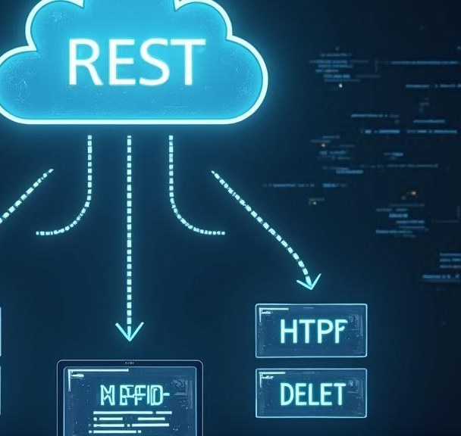
REST Fundamentals
Annotation Support: @Path, @GET, @POST simplify endpoint creation and HTTP method binding.
Content Negotiation: Supports multiple media types like JSON, XML through @Produces and @Consumes.
Integration: Works seamlessly with frameworks like Jersey, RESTEasy, and Spring Boot.
REST (Representational State Transfer) is an architectural style that leverages standard HTTP methods such as GET, POST, PUT, and DELETE for communications between clients and servers. RESTful services are resource-oriented, meaning they operate on the resources represented by URLs. This lightweight approach enables better scalability and performance, especially in web and mobile applications.

Slide 14
Java API for RESTful Services (JAX-RS)
Simplifying REST Service Development
Annotation Support: @Path, @GET, @POST simplify endpoint creation and HTTP method binding.
Content Negotiation: Supports multiple media types like JSON, XML through @Produces and @Consumes.
Integration: Works seamlessly with frameworks like Jersey, RESTEasy, and Spring Boot.
Photo by Nate Grant on Unsplash
Notes:
JAX-RS (Java API for RESTful Web Services) standardizes the development of REST APIs in Java by using simple annotations. By annotating Java classes and methods with directives like @Path, @GET, or @POST, developers can rapidly expose services over HTTP with minimal boilerplate code.
JAX-RS supports content negotiation through @Produces and @Consumes annotations. This allows services to respond in different formats such as JSON or XML depending on client requirements, thus improving flexibility and usability.
JAX-RS is well-supported across the Java ecosystem. It integrates smoothly with popular implementations like Jersey and RESTEasy, and is fully compatible with microservice frameworks such as Spring Boot. This makes it a cornerstone for building scalable and modern REST APIs in enterprise and cloud-native environments.

Slide 15

Implementing REST with JAX-RS
Step-by-Step RESTful API Development
Annotation Support: @Path, @GET, @POST simplify endpoint creation and HTTP method binding.
Content Negotiation: Supports multiple media types like JSON, XML through @Produces and @Consumes.
Integration: Works seamlessly with frameworks like Jersey, RESTEasy, and Spring Boot.
Define Resource Path: Use @Path to assign URI to a resource class or method.
Bind HTTP Methods: Use @GET, @POST, @PUT, @DELETE to associate operations with endpoints.
Run and Validate: Deploy on servers like Tomcat or Jetty; test using Postman or curl.
Notes:
To implement a RESTful service in Java using JAX-RS, developers begin by defining resource classes and annotating them with @Path to expose them via HTTP URIs. Each HTTP method is bound to a specific operation using annotations like @GET or @POST, which simplifies request handling.
Developers then define the response content using annotations such as @Produces and handle input data with @Consumes. This enables seamless data exchange in formats like JSON or XML. Lightweight containers like Tomcat or Jetty are ideal for deploying such services due to their speed and minimal setup.
Testing tools such as Postman or curl can be used to interact with the service endpoints. This step helps validate the proper functioning of each operation and ensures accurate serialization of responses, making JAX-RS both powerful and accessible for modern API development.

Slide 16
REST Code Examples
A simple RESTful web service can be implemented using JAX-RS in Java. Consider the following example:
@Path("/hello")
public class HelloRestService {
@GET
@Produces(MediaType.TEXT_PLAIN)
public String sayHello() {
return "Hello, RESTful World!";
}
}
In this service, the @Path annotation defines the URI, and @GET specifies that the method handles HTTP GET requests, providing a simple text response.

Slide 17
REST Architecture
The architecture of a RESTful web service relies on stateless interactions and typically follows this flow: the client sends an HTTP request to a specified endpoint, which processes the request and returns the resource representation in JSON or XML format. This separation of concerns enhances the scalability and performance of web applications.

Slide 18
Security Considerations

Slide 19

SOAP Security Mechanisms
SOAP employs WS-Security to ensure message confidentiality and integrity, utilizing methods such as XML encryption, digital signatures, and security tokens (like SAML). These features are critical for enterprise applications, particularly when sensitive data is transmitted.

Slide 20

REST Security Practices
RESTful services often implement HTTPS to provide encryption during data transmission, combined with OAuth 2.0 for delegated access and JSON Web Tokens (JWT) for secure authentication. Input validation and rate limiting are also essential practices to prevent abuse or attacks on REST APIs.

Slide 21

Comparative Analysis
Feature | RESTful API | SOAP API
Protocol | HTTP/HTTPS | HTTP, SMTP, TCP
Data Format | JSON, XML, HTML, plain text | Only XML
Flexibility | Lightweight, flexible | Rigid, standard-based
Performance | Faster, less bandwidth | Slower, more overhead
Security | HTTPS, OAuth | WS-Security (enterprise-level)
State | Stateless | Stateless or stateful
Use Cases | Web & mobile applications | Enterprise apps, banking, telecom
W

Slide 22
Deployment and Trends

Slide 23

Deployment Methods
Traditional Deployment: WAR/EAR files deployed on Java EE servers or servlet containers like Tomcat.
CI/CD Pipelines: Automate builds, testing, and deployment using Jenkins, GitHub Actions, or GitLab CI.
Containerization: Use Docker and Kubernetes for scalable, portable, and resilient deployment.

Slide 24


Emerging Technologies
Current trends in web services are seeing a rise in cloud-native architectures, serverless computing, and the adoption of new protocols such as gRPC and WebSockets that support high-performance, real-time communication. These technologies are revolutionizing how web services are developed and deployed.

Slide 25
Conclusions and future
Standard Evolution: Jakarta EE, OpenAPI, and MicroProfile are driving future enhancements.
Cloud-Native Readiness: Serverless Java, service meshes, and Kubernetes-native tools are gaining traction.
AI and Analytics Integration: Web services increasingly act as connectors for ML models and data pipelines.

